Slide 1

School of Engineering & Sciences
Department of Electronics & Communication Engineering
Smart Pesticide Application System
Group Code:ECO2526UGP-20 Course Code : 12BTC0721
Topic: New
Roll No. | Div. | Enrolment No. | Name of Student
D2234010 | ECO | MITU23BTECD010 | Om Pawar
2224066 | ECO | MITU22BTEC0011 | Anuja Chitode
2224107 | ECO | MITU22BTEC0001 | Abhishek Palve
2224077 | ECO | MITU22BTEC0090 | Shruti Saware
Name of Guide | Prof.Dr. Sachin Patil

Slide 2

Sponsorship Details (if any)
Sponsored
logo
Sponsored by: Name of company/lab/institute/university etc.
Profile of company/lab/institute/university etc.
Sponsorship in term of:
Attach sponsorship documents
1- 2 slides

Slide 3
Contents
Introduction
Literature Review & Field Survey
Identification of Gaps/Scopes of Work
Problem Statement
Objectives
Methodology
Actual project work (Own Contribution)
Result and Discussion
Cost Sheet
Conclusion
Future Scope
Project Work Action Plan
Project Based Accolades
Reference

Slide 4
Introduction
Smart Pesticide Application System focuses on automating and optimizing the pesticide application process in open-field grape cultivation.
The system detects early signs of crop diseases using camera-based monitoring and machine learning, ensuring timely and accurate identification of infections.
Once a disease is detected, the system automatically applies pesticide precisely to the affected grape plants through a controlled spraying mechanism.

Slide 5
Literature Review & Field Survey
Ref. No. | Paper Title | Author Names, Name of Journal/Conference, Volume No., Year of publication etc. | Findings
1 | Trend Technologies for Robotic Fertilization Process in Row Crops | Christyan Cruz Ulloa, Anne Krus, Antonio Barriento, Jaime del Cerro and Constantino Valero published: 27 April 2022 doi: 10.3389/frobt.2022.808484 | This work focuses on analyzing laser sensors and multispectral/RGB cameras to extract crop characteristics, providing key data (NDVI, RGB histograms, point clouds) for informed decisions in robotic fertilization.
2 | Automated Fertilizer Mixer System for Fertigation Farming | M.F.Saaid, MK Nordin, Ahmad Ihsan Mohd Yassin, and Nooritawati Md Tahir | The purpose of this project is to study the effectiveness of the system in mixing the raw ingredients of fertilizers.

Slide 6
Ref. No. | Paper Title | Author Names, Name of Journal/Conference, Volume No., Year of publication etc. | Findings
3 | Automated Fertigation System Using IoT | Omer Mohamed Elhassan Ahmed; Abdalla A. Osman; Sally Dafaalla Awadalkarim | The fertilization control is the process of adjusting the potential of Hydrogen (pH) and soil electrical conductivity (EC) as in preset database and thereby acidity and alkalinity.

Slide 7
Identification of Gaps/Scopes of Work
Identification of Gaps:
• Manual monitoring of grape leaves is time-consuming.
• Early detection of grape leaf diseases is difficult using traditional methods.
• Excessive pesticide spraying on the entire crop increase chemical usage.
Scope of the Project:
• Use Raspberry Pi and AI for grape leaf disease detection.
• Develop a robot system for automatic field monitoring.
• Enable targeted pesticide spraying only on diseased leaves.

Slide 8
Problem Statement
To automatically detect crop diseases using image-based machine learning and apply the correct pesticide
Objectives
Automate pesticide spraying using sensors and a Raspberry Pi–controlled pump system.
Process real-time data on the Raspberry Pi to control spraying accurately and avoid overuse of chemicals.
Reduce manual labour and health risks by minimizing human exposure to pesticides.
Increase crop protection efficiency through timely, precise, and automated pesticide application.

Slide 9
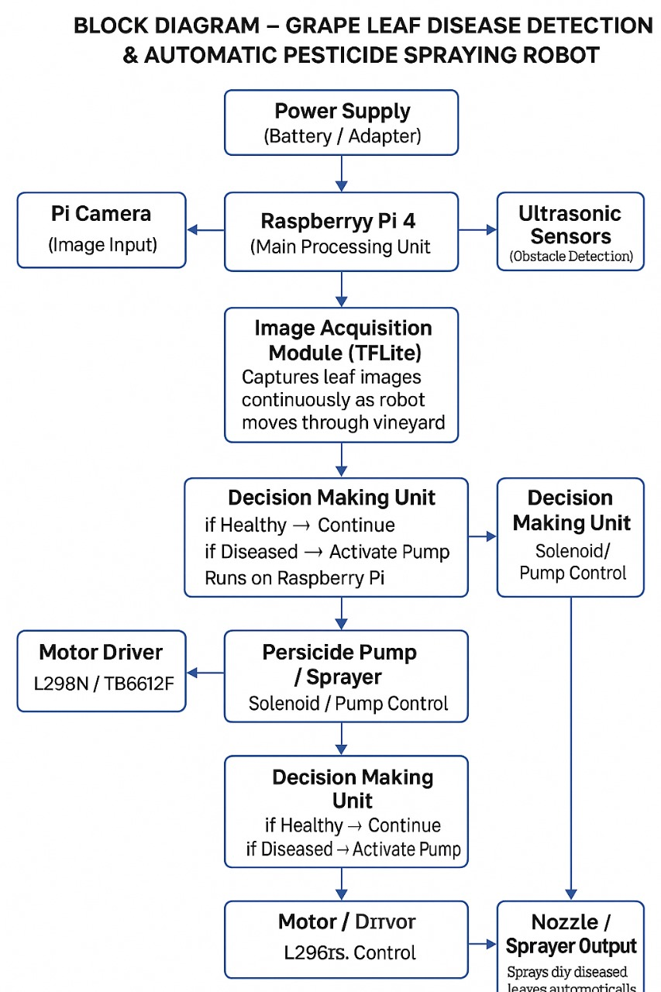
Methodology

Slide 10
Simulation

Slide 11
Fundamental Background
Plant disease detection is done using image analysis of grape leaves.
A Raspberry Pi processes the captured images and detects disease using an AI model.
The system is implemented on a robot that can move in the field
When a diseased leaf is detected, the system activates the pump to spray pesticide only in the affected area.
This approach helps reduce chemical usage, detect disease early, and improve crop health.

Slide 12
Actual Project Work
Set up Raspberry Pi for AI image processing.
Connected Arduino Uno with motors, relay, and sensors.
Integrated camera to capture grape leaf images.
Assembled the robot cart with wheels, motors, and pump system.
Tested the system for disease detection and pesticide spraying.

Slide 13
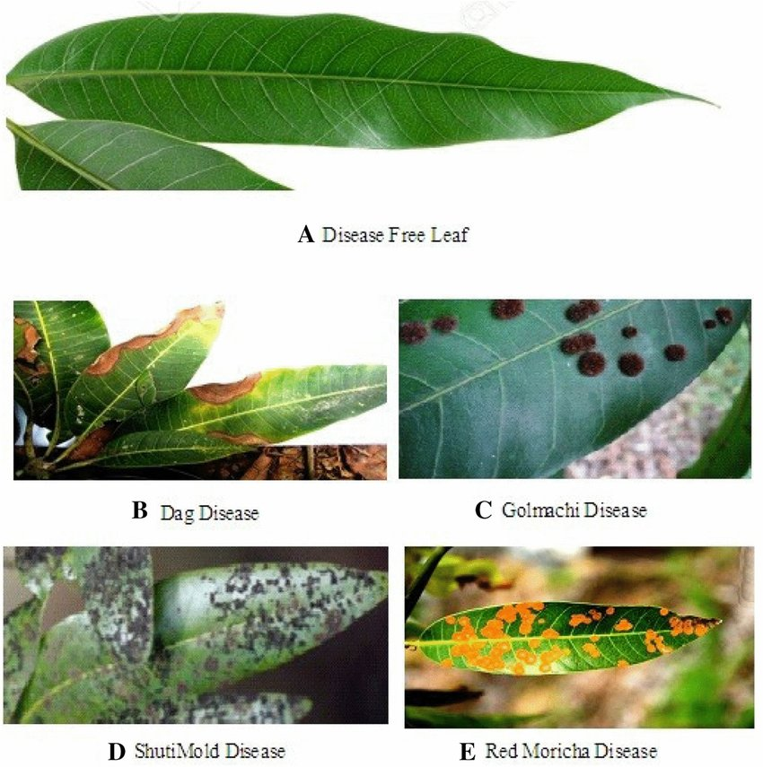
Results & Discussion

Slide 14
Cost Sheet
S. N. | Date | Particular | Amount (Rs.)
1. | 15-10-25 | Raspberry Pi 4(4GB) | 4,872
2. | 15-10-25 | Raspberry Pi 4 Power Supply | 635
3. | 15-10-25 | 5 TET LCD | 2,118
4. | 24-2-26 | DC 5V Ultrasonic module,12v Battery Pack,12v-5v converter, HC-SR04 Ultrasonic module | 2,740
5. | 24-2-26 | 12v Motor, Driver module, Wheels, Caster wheel | 1,910
6. | 9-3-26 | Motor,PushButton,Zero pcb servo | 660
7. | 9-3-26 | 12*8 PU Unequal union (4) | 160
8. | 9-3-26 | 80D PU Elbow &80D Inline hand | 225
9. | 9-3-26 | PU Tube &PU equal Tee 8-OD | 90
10. | 14-3-26 | Webcam | 1,200
Total- |  |  | 14,610

Slide 15
Conclusion
This project demonstrates how intelligent automation can support farmers by identifying diseases early and responding with timely pesticide action.
The approach promotes safer handling practices and encourages more sustainable pest-management methods in grape cultivation.
The progress achieved so far confirms that the system is technically feasible and ready for further integration, optimization, and real-world testing.

Slide 16
Future Scope
Improve the AI model on Raspberry Pi to detect more types of plant diseases with higher accuracy.
Integrate IoT technology to monitor crop health and system data remotely through a mobile or web application.
Expand the robot system for large farms and different crops, making the system more efficient and useful for farmers.

Slide 17
Project Work Action Plan
Sr. No. | Activity |  |  | Duration
 |  | July 2023 | August 2023 | Sept. 2023 | Project Overview Assessment | Sept. 2023 | Oct. 2023 | Mid Term Assessment | Oct. 2023 | Nov. 2023 | End Term / Phase I Assessment | Jan. 2023 | Feb. 2023 | Project Overview Assessment |  |  | Mid Term Assessment |  |  |  | End Term / Phase II Assessment
1
2
3
4
5
6
UG Mini Project
UG / PG Project

Slide 18
Activity Schedule Guidelines:
Mapping of work activity from start to end with time bonding
Activity like: Literature Survey, CAD modelling, software analysis, testing and analysis, publication, report writing etc.
No. of activity may vary with respect to work content
UG Mini project activity schedule for 1 semester
UG/PG Project activity schedule for 1 academic year

Slide 19
Project Based Accolades (If Any)
Paper/Patent/Copyrights publication details
Project Competition Participation / Award
Entrepreneurship details
Consultancy details
Any significant achievement in project work
Attach appropriate documents

Slide 20
Reference
Journal / Conference:
1.Paper :Rajendra Prasad et al., “Camera-Based Pest Detection and Robotic Targeted Spraying System for Smart Agriculture,” 2021.
2.Paper :D. Meena et al., “Microcontroller-Based Automated Pesticide Sprayer Using Motorized Agricultural Vehicle,” 2023.

Slide 21


Slide 22


Slide 23

Important Guidelines
Consistency in content and delivery is required
Appropriate coordination within a group is required
Keep bullet points brief and avoid use of large paragraph
Simple diagrams are great communicators
Use actual photograph and working video of project work whereas applicable
Time yourself during presentation
As per wish of students template design may change with satisfying stated contents & guidelines.
Propelling force for effective Technical Presentation
In depth Knowledge of work
Systematic Planning
Smart Execution

